Slide 1
Seminar project
鄭宇翔

Slide 2
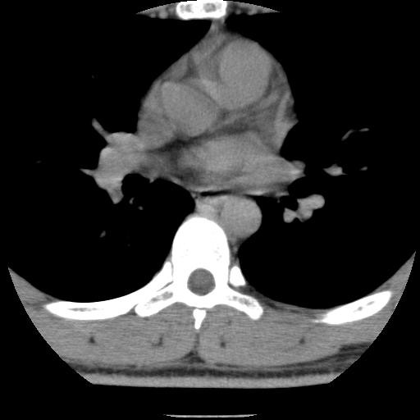
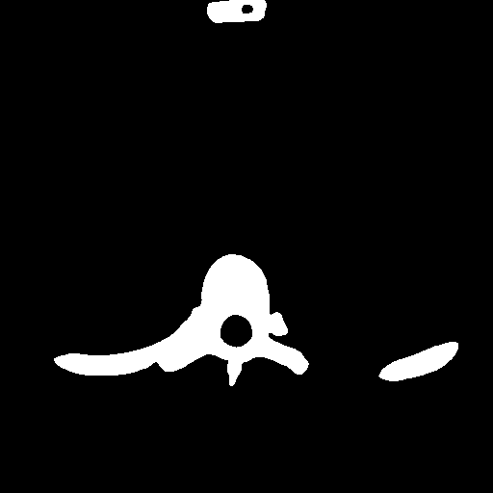
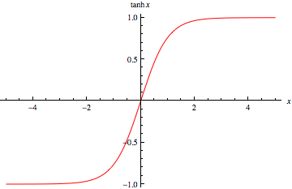
Architecture Unet
x2
x2
x2
x2
tanh
Conv
relu
TransConv
leakyrelu
batchnorm
tanh

Slide 3
Architecture Unet
One important modification in Unet architecture is that in the upsampling part we have also a large number of feature channels, which allow the network to context information to higher resolution layers

Slide 4
DenseNet cvpr2017 best paper
Idea from stochastic depth regularization of residual networks (eccv 2016)
training of deep residual networks by dropping layers randomly during training. This shows that not all layers may be needed and highlights that there is a great amount of redundancy in deep (residual) networks. Our paper was partly inspired by that observation
Feature map reuse
Notes:
1.Network 可以不是漸進式的網路
2. redundancy

Slide 5
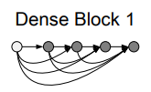
DenseNet
DenseNet layers can be accessed by all subsequent layers. This encourages feature reuse throughout the network
ensure maximum information flow between layers in the network, we connect all layers (with matching feature-map sizes) directly with each other
Feature reuse(each layer ) : DenseNet with only 0.8M trainable parameters is able to achieve comparable accuracy as the 1001-layer ResNet with 10.2M parameters.
Can see as batchnorm

Slide 6
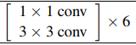
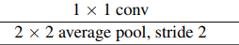
Architecture DenseNet cvpr2017 best paper
Output_channel=
Input_channel+Layer * Growth rate(32).
64
32
32
32
32
32
32
[ ]
256
Layer conact
each layer
DenseBlock
1x1 conv
Avg pool
Transition Layer
Reduce channels

Slide 7
Architecture DenseNet cvpr2017 best paper
64
160
80
272
6
12
2
Transition
2
Transition
DenseBlock
DenseBlock
64
96
48
80

Slide 8
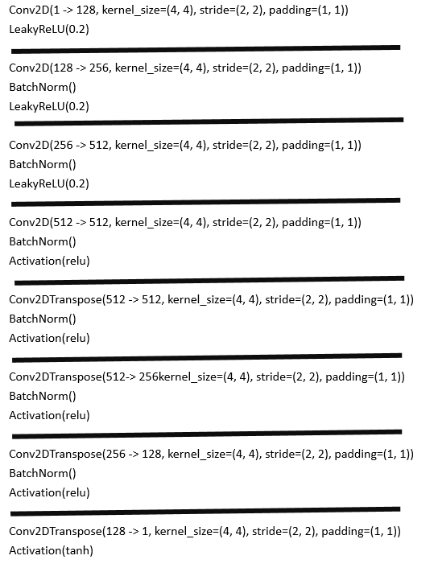
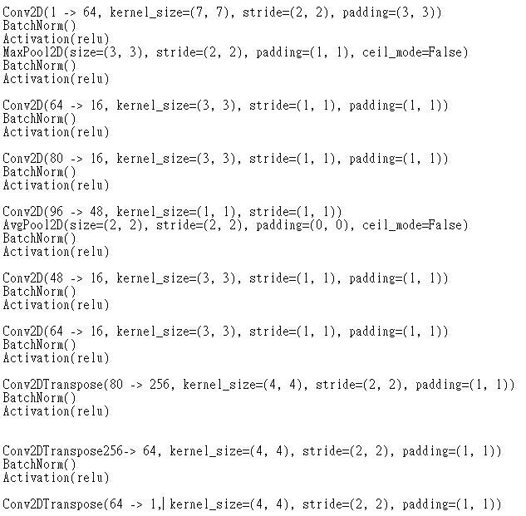
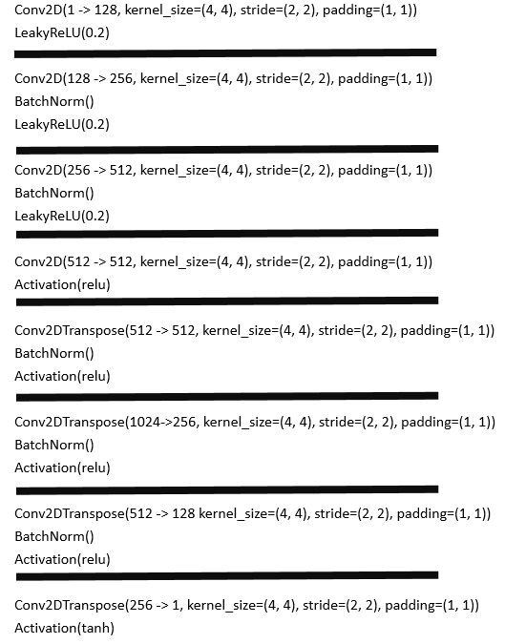
Experiments
8 layer
8 layer
9 layer

Slide 9
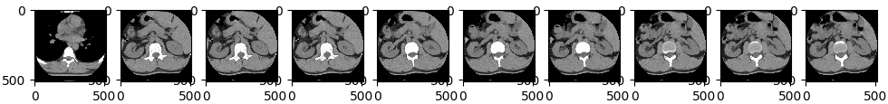
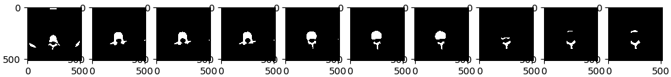
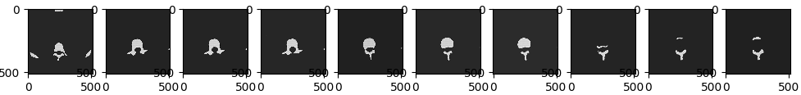
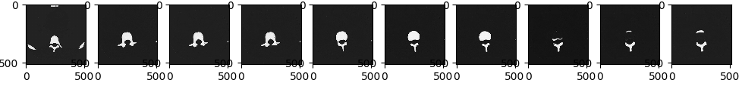
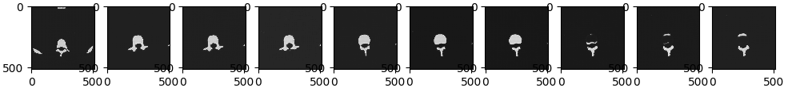
Test in dataset1(seminar (jpg and bmp))
data
Ground truth
Auto encoder
Unet
DenseNet

Slide 10
Qualitative result ( test on other dataset (dicom w/ preprossing))

Slide 11
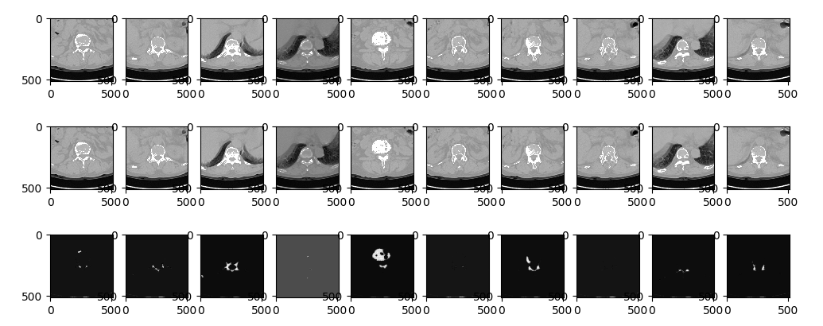
More –autoencoder (infer on other dataset (dicom w/ preprossing no fine tune))

Slide 12
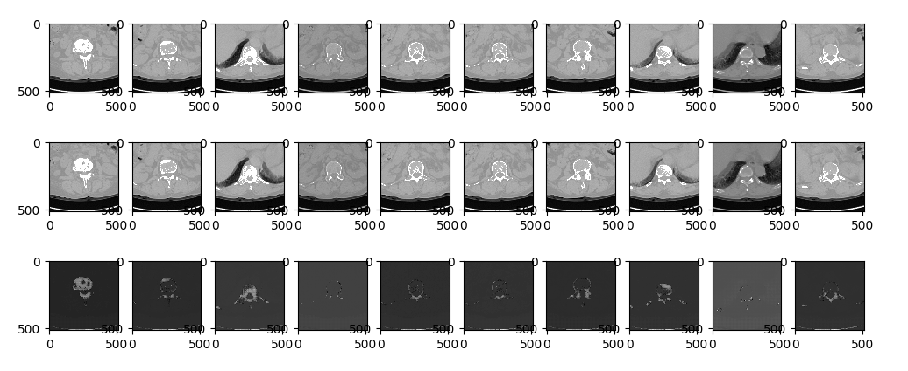
More –unet ( test on other dataset (dicom w/ preprossing no fine tune))

Slide 13
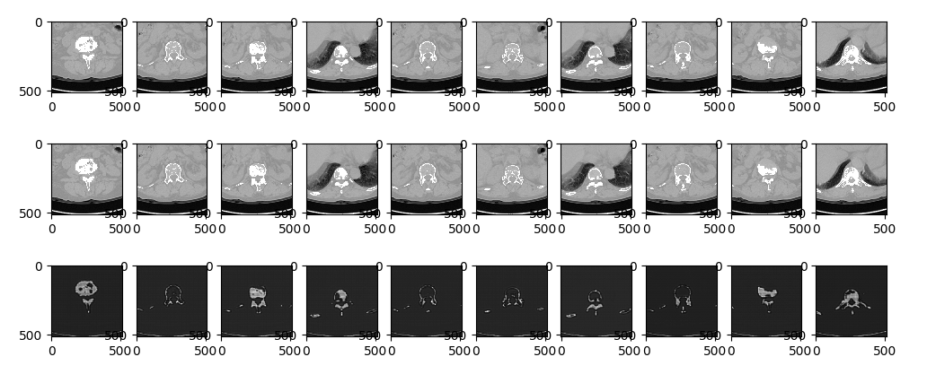
More – DenseNet (infer on other dataset (dicom w/ preprossing no fine tune))
Good
Shape
structure

Slide 14
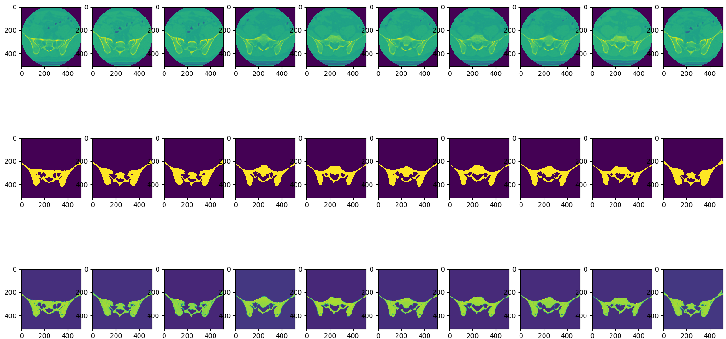
Train dicom DenseNet (no preprocessing)

Slide 15
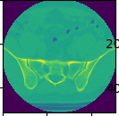
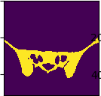
Data limitaiton
We should modify ground truth

Slide 16
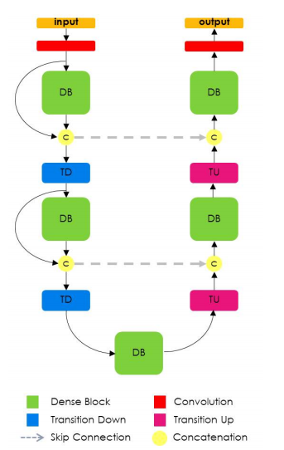
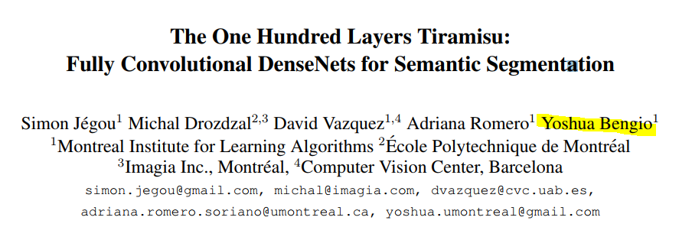
DenseNet Unet fusion

Slide 17
ensure maximum information flow(high resolution ,cross layer,dilation conv) between layers in the network

Slide 18
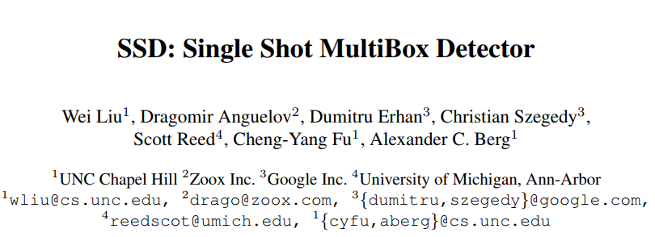
ECCV2016
鄭宇翔

Slide 19
outline
Introduciton
Related Work (RCNN~ YOLO)
The Single-shot Detector
Experimental Results
Conclusions
Recent( FPN, DSSD)

Slide 20
abstract
present a method for detecting objects in images using a single deep neural network
the network combines predictions from multiple feature maps with different resolutions to naturally handle objects of various sizes
SSD is simple relative to methods that require object proposals because it completely eliminates proposal generation and subsequent pixel or feature resampling stages and encapsulates all computation in a single network
SSD has competitive accuracy to methods that utilize an additional object proposal step and is much faster
Notes:
A method for object using a single deep neural net (RPN)
This network combines predictions from multiple feature maps with different resolutions
Propose simple method for region proposal it completely eliminates proposal generation and pixel or feature resampling stages
Comptetitve ac and fast

Slide 21
Introduction
state-of-the-art object detection systems are variants of the following approach: hypothesize bounding boxes, resample pixels or features for each box, and apply a highquality classifier.
current leading results on PASCAL VOC,COCO,ILSVRC detection all based on Faster R-CNN albeit with deeper features such as (Residual ,VGG)
Notes:
State of the art object are following approach 先給出大概覺得有物體的地方 然後 resample pixels or feature for each box apply high quality classifier
In 2016 bench mark all based on faster rcnn with resnet

Slide 22
RCNN ( two stage)
RCNN
fastRCNN
fasterRCNN
region proposal
once
region proposal
RPN
yolo
detection net
You only look once
feature extraction
SSD
feature extraction
Single shot multibox
Detector
fastRCNN
classier
locator
classfication
regression

Slide 23
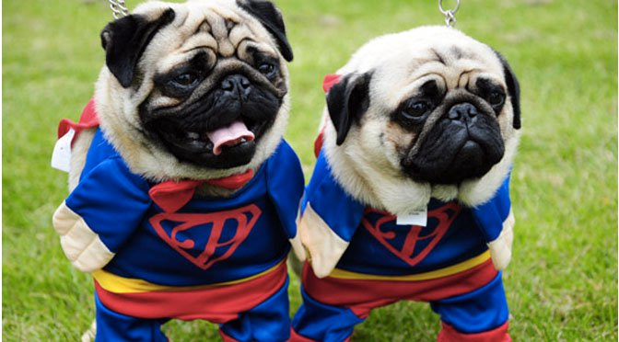
RCNN
Selective search
1.Slowly
2.Many Region proposal
3.runing time depends on the
number of proposal
4.Model fixed
1.selective search
2.Trainsfer learning(alex,VGG)
3.svm: classification
4.bounding box:regression
resize
resize
Convs
Convs
SVM
BBOX
SVM
BBOX
Notes:
Selective search (heuristic)= > much bounding box
Pre train Convs extraction feature
SVM
Many proposal over lapping (convs each proposal)
給一張圖 經過ss => resize => conv (ALEX resnet inception) 捲機網路只是抽feature (image net 最後一層拿掉)

Slide 24
fastRCNN
Convs
Different shape
1.overlapping:
Many region convs
=> One convs
2.ROI pooling
ROI Pooling
ROI Pooing
output
Dense
Num_Regions x Num_channels x n x m
softmax
BoxReg
50 | 34 | 34 | 26
32 | 78 | 19 | 73
23 | 34 | 23 | 32
34 | 56 | 56 | 78
(0,0),(3,3)
78 | 73
56 | 78
Notes:
Rcnn region proposal overlapping
Roi pooling vs maxpooling
Increase resolution
Cut evenly
原先一張圖 2K region => conv
只做一次卷機 區域重疊做兩次卷機浪費
形狀不一樣 =>roi pooling

Slide 25
fastRCNN
Convs
Different shape
1.overlapping:
Many region convs
=> One convs
2.ROI pooling
ROI Pooling
ROI Pooing
output
Dense
Num_Regions x Num_channels x n x m
softmax
BoxReg
50 | 34 | 34 | 26
32 | 78 | 19 | 73
23 | 34 | 23 | 32
34 | 56 | 56 | 78
(0,1),(3,3)
78 | 73
56 | 78
Runtime dominated by
region proposals(inference)
Notes:
Imporve Convs
may decrease ac
Roi pooling vs maxpooling
Increase resolution
Cut evenly

Slide 26
fasterRCNN
RPN(region proposal net):
Background or foreground ?
Convs
1.RPN(SS)
Resample
Pixel and feature for each bounding box
ROI Pooling
Dense
Convs
softmax
BoxReg
BoxReg
softmax
refine
class
Back ground?
Notes:
Replace selective search
RPN foreground or background

Slide 27
RPN
RPN(region proposal net):
Background or foreground ?
VGG(ZF) channels=512
CONV (kernel =3 ,padding = 1 ,channels= 512)
Vgg or zf
1x1
1x1
Convs
Cls ( 2 (back or foreground) * 9 anchor)
18
Boxreg(4 (coord)* 9 )
36
BoxReg
softmax
Back ground?
Notes:
Select search most background

Slide 28
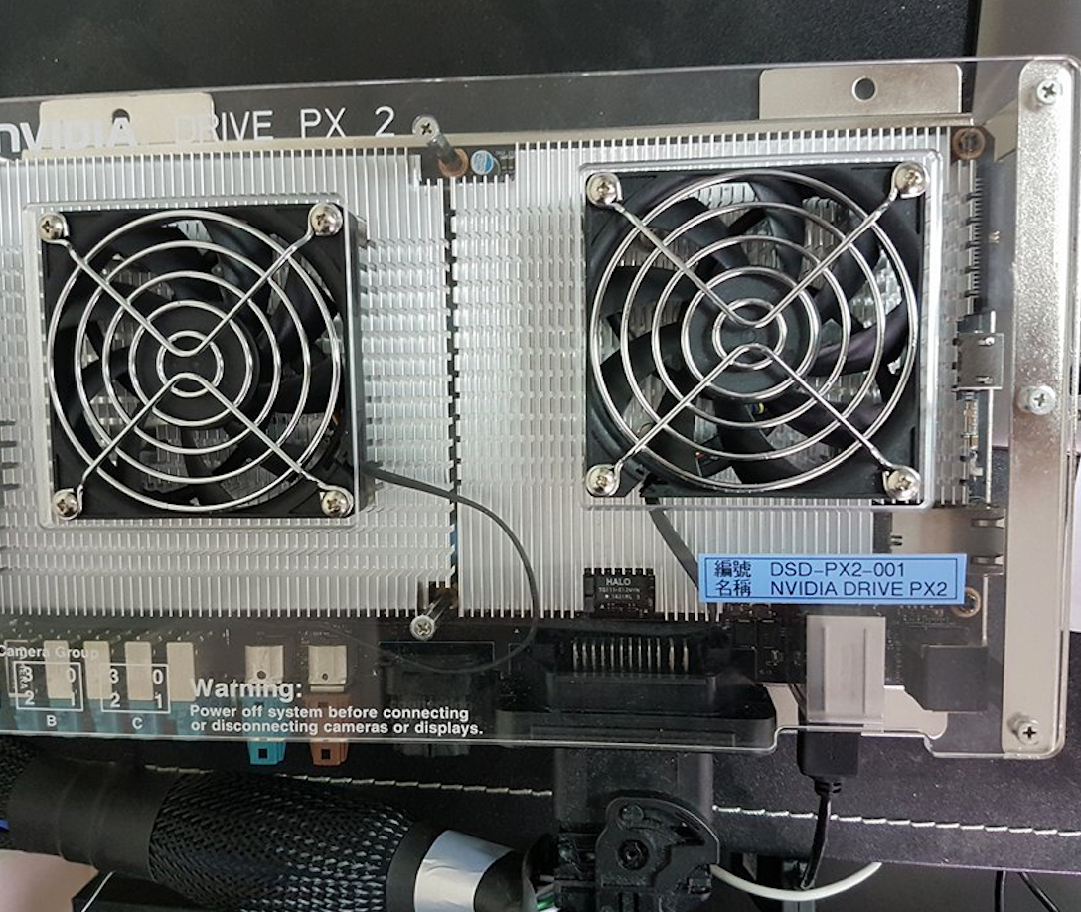
Introduction
too computationally intensive for embedded system and,even with high-end hardware,too slow for real time

Slide 29
Introduction
This paper presents the first deep network based object detector that does not resample pixel or features for bounding box hypotheses and is as accurate as approaches that do
improvement in speed comes from eliminating bounding box proposals and the subsequent pixel or feature resampling stage

Slide 30
Introduction
Our improvements include using a small convolution filter to predict object categories and offsets in bounding box locations, using separate predictors(filters) for the later stage of a network in order to perform detection at multiple scales
using multiple layers for prediction at different scales - we can achieve high-accuracy

Slide 31
Introduction
a single-shot detector for multiple categories that is faster than YOLO,and significantly more accurate
core of SSD is predicting category scores and box offsets for a fixed set of default bounding boxes using small convolution filter applied to feature maps
to achieve high detection accuracy we produce predictions of different scales from different feature maps of different scales,and explicitly separate predictions by aspect ratio

Slide 32
The Single Shot Detector (SSD)
SSD approach is based on a feed-forward convolutional network that produces a fixed-size collection of bounding boxes and scores for the presence of object class instances in those boxes, followed by a non-maximum suppression step to produce the final detections.
The early network layers are based on a standard architecture used for high quality image classification (truncated before any classification layers), which we will call the base network .

Slide 33
Model
We then add auxiliary structure to the network to produce detections with the following key features:
1.Multi-scale feature maps for detection
2.Convolutional predictors for detection
3.Default boxes and aspect ratios

Slide 34
Multi-scale feature maps for detection
add convolutional feature layers to the end of the truncated base network(VGG ,residual). These layers decrease in size progressively and allow predictions of detections at multiple scales. The convolutional model for predicting detections is different for each feature layer (yolo operate on a single scale feature map)

Slide 35
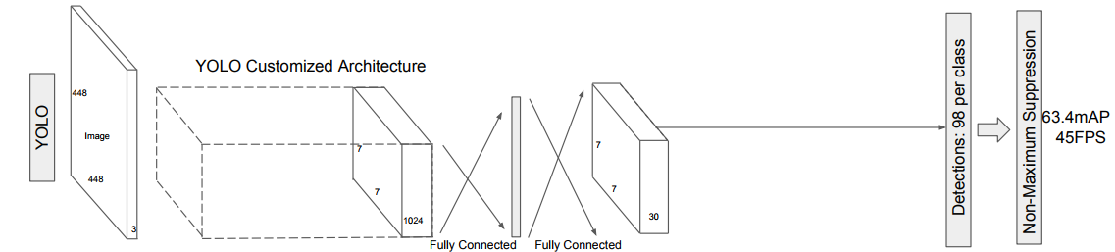
yolo
point x,y bbox w,h
Confidence
=5
class (20)
Convs
anchor box:
(ssd fasterrcnn)
overlapping small object
Per grid
= 2
3x3x30
Maxclass ‘car’
*
softmax
BoxReg
loc

Slide 36
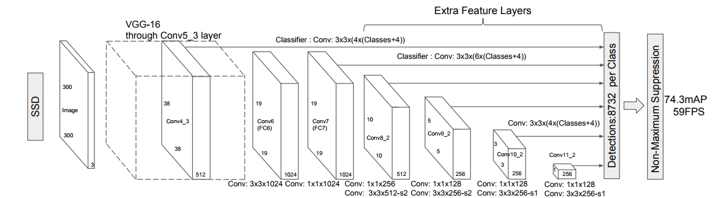
Convolutional predictors for detection
Each added feature layer (or optionally an existing feature layer from the base network) can produce a fixed set of detection predictions using a set of convolutional filters

Slide 37
Convolutional predictors for detection
adds several feature layers to the end of a base network, which predict the offsets to default boxes of different scales and aspect ratios and their associated confidences
For a feature layer of size m × n with p channels, the basic element for predicting parameters of a potential detection is a 3 × 3 × p small kernel that produces either a score for a category, or a shape offset relative to the default box coordinates.

Slide 38
Convolutional predictors for detection
At each of the m × n locations where the kernel is applied, it produces an output value. The bounding box offset output values are measured relative to a defaultbox position relative to each feature map location (cf the architecture of YOLO[5] that uses an intermediate fully connected layer instead of a convolutional filter for this step)

Slide 39
Default boxes and aspect ratios
the position of each box relative to its corresponding cell is fixed.
At each feature map cell, we predict the offsets relative to the default box shapes in the cell, as well as the per-class scores that indicate the presence of a class instance in each of those boxes
we compute c class scores and the 4 offsets relative to the original default box shape. This results in a total of (c + 4)k filters that are applied around each location in the feature map, yielding (c + 4)kmn outputs for a m × n feature map
apply them to several feature maps of different resolutions. Allowing different default box shapes in several feature maps let us efficiently discretize the space of possible output box shapes.

Slide 40
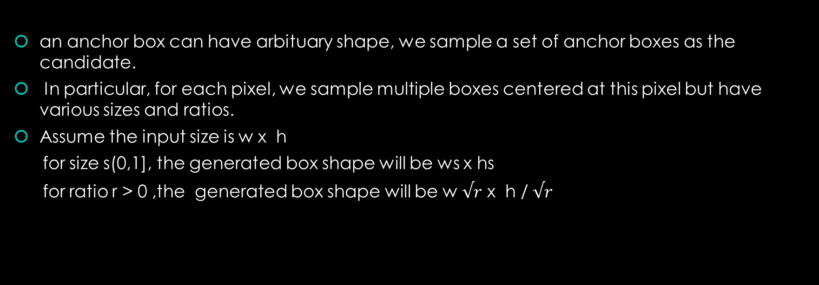
Default anchor boxes
an anchor box can have arbituary shape, we sample a set of anchor boxes as the candidate.
In particular, for each pixel, we sample multiple boxes centered at this pixel but have various sizes and ratios.
Assume the input size is w x h
for size s(0,1], the generated box shape will be ws x hs
for ratio r > 0 ,the generated box shape will be w $√r$ x h / $√r$
Notes:
Avg the same
中心點
多大
長寬比
Faster rcnn sizenum x rationum
Ssd sizenum + rationum -1

Slide 41
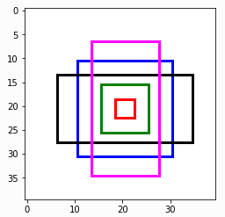
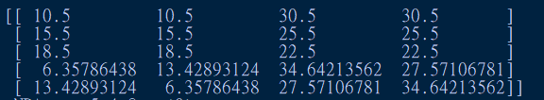
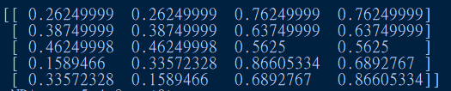
Default anchor boxes
accepts n size and m ratios to generate n+m -1 boxes for each pixel
First I boxes are generated from sizes[i], ratio[0] if i <= n, otherwise size[0],ratios[i-n]
Size [0.5,0.25,0.1] ratio[1 ,2, 0.5] => [0.5,1] [0.25,1] [1,1][0.5,2][0.5,0.5]
Notes:
[[ 0.26249999 0.26249999 0.76249999 0.76249999]
[ 0.38749999 0.38749999 0.63749999 0.63749999]
[ 0.46249998 0.46249998 0.5625 0.5625 ]
[ 0.1589466 0.33572328 0.86605334 0.6892767 ]
[ 0.33572328 0.1589466 0.6892767 0.86605334]]
[[ 10.5 10.5 30.5 30.5 ]
[ 15.5 15.5 25.5 25.5 ]
[ 18.5 18.5 22.5 22.5 ]
[ 6.35786438 13.42893124 34.64213562 27.57106781]
[ 13.42893124 6.35786438 27.57106781 34.64213562]]

Slide 42
Predict bounding box
Transfer the current default(anchor) box to correct bounding box (delta location)
Assume b is one of the sampled default box while Y is the ground truth want to predict the delta locations delta(Y,b) , which is a 4-lenth vector
[t_x, t_y , t_width, t_height ] t_x = (Y_x - b_x) / b_width t_y = (Y_y – b_y) / b_height t_width = (Y_width – b_width) / b_width t_height = (Y_height – b_height) / b_height
Ouput channel = num_anchor box * 4
A-th box => a *4 ~ a *4+3
Notes:
Ground truth [100, 100, 200,200] [10,10,20,20] bounding box [90,90,200,200][8,8,20,20]

Slide 43
Predict classes
For each anchor box ,we want to predict the associated class label
This prediction by using convolution layer . Choose a kernel of size3x3 padding 1 => input size = output size
The confidence scores for the anchor box class labels are stored in channels

Slide 44
Predict classes
Output channels = num_anchors * (num_classes + 1 )
( I ,j ,output)
Anchor * (num_class + 1) => background score Anchor * (num_class + 1)+1+b => b-th object score

Slide 45
Training
key difference between training SSD and training a typical detector that uses region proposals, is that ground truth information needs to be assigned to specific outputs in the fixed set of detector outputs. Some version of this is also required for training in YOLO[5] and for the region proposal stage of Faster R-CNN
Training also involves choosing the set of default boxes and scales for detection as well as the hard negative mining and data augmentation strategies.

Slide 46
SSD
Classic model (VGG residual)
convs
32,32,num_anchors * (num_classes + 1 )
1.classification = object_class+1(background)
2.muti scale detection
Output channels =
num_anchors * (num_classes + 1 )
1,64,32,32
4096 defalutbox
softmax
BoxReg
Ouput channel =
num_anchor box * 4
Default box
Class = 2
…
4160,4
32,32, num_anchor box * 4
Convs
Pred class
…
1,128,4,4
64 defalutbox
softmax
4160,3
BoxReg
Gt class
1,3
Output default box = (4160,4)
Output class = (4160,3) Output bbox = (16640)
Bouning box
(1,4)
Notes:
Downsample default box size increase
4160 small region for predict vs classification => once predict

Slide 47

Matching strategy
For each ground truth box we are selecting from default boxes that vary over location, aspect ratio, and scale.
We begin by matching each ground truth box to the default box with the best jaccard overlap
we then match default boxes to any ground truth with jaccard overlap higher than a threshold (0.5). allowing the network to predict high scores for multiple overlapping default boxes rather than requiring it to pick only the one with maximum overlap
Notes:
Intersection of union
除了選最像的 >0.5 也選起來 當positive

Slide 48
Hard negative mining
most of the default boxes are negatives, especially when the number of possible default boxes is large
we sort them using the highest confidence loss for each default box and pick the top ones so that the ratio between the negatives and positives is at most 3:1

Slide 49
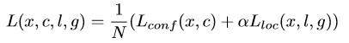
Training objective
Let be anindicator for matching the i-th default box to the j-th ground truth box of category p. In the matching strategy above, we can have . The overall objective loss function is a weighted sum of the localization loss (loc) and the conﬁdence loss (conf):
Notes:
X p ij 第i個default box 與類別P地 j 個ground truth box match
Match strategy 選最像的 還有 > 0.5 的 一個j 配很多 defult bounding box 都當positive 所以 總和超過1
N default box match 到GT bounding box 數量 N = 0 loss = 0

Slide 50
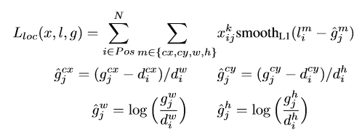
Localization loss
Localization loss is smooth L1 loss between the predicted box(l)
and the ground truth box (g)

Slide 51
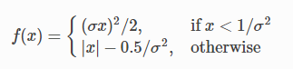
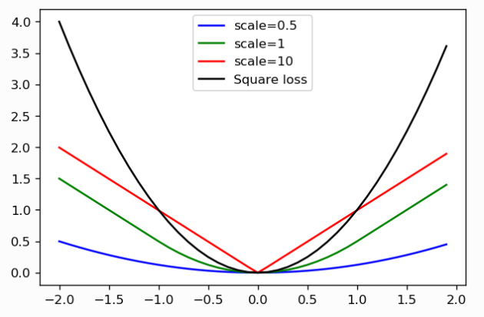
L1 Loss
L2 sensitive if error bigger => error penalty much higher
Use L1 error => linear not square increase
Notes:
If error > 1 , so the model is much more sensitive to this example, and adjusts the model to minimize this error. . If this example is an outlier, the model will be adjusted to minimize this single outlier case
L2 比較大的誤差的懲罰很高。 稍微緩和一點絕對損失函數（L1損失）它是隨著誤差線性增長，而不是平方增長。但這個函數在0點處導數不唯一，因此可能會影響收斂。 解決辦法是在0點附近使用平方函數使得它更加平滑。

Slide 52
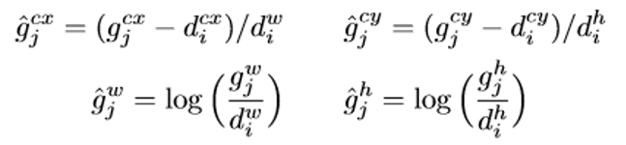
Localization loss
Ground truth [100, 100, 200,200] [10,10,20,20] bounding box [90,90,200,200][8,8,20,20]
Pair1 (100 -90) , pair2 (10 – 8)
In practice (100 – 90 / 100) , (10 – 8 / 10)
Notes:
取log decrease 讓loss 比重下降

Slide 53
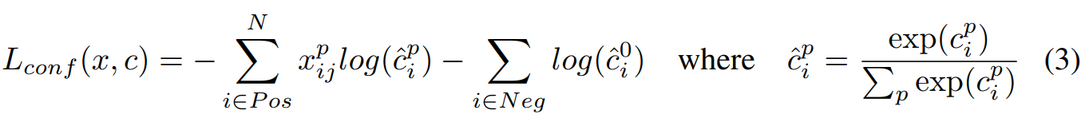
softmax
The conﬁdence loss is the softmax loss over multiple classes conﬁdence
Care negative
Notes:
softmax function used for multi-classification model it returns the probabilities of each class and the target class will have the high probability.
簡單講就是你預測錯比預測對的損失要大，預測錯得離譜比預測錯得輕輕的損失要大
正負樣本比例極度不平衡，以及（Loss Function）的來源大多數被容易歸類的負樣本所佔據
y=[0,0,0,1,0] （softmax的输出）p=[0.2,0.3,0.4,0.6,0.5] L=-log(0.6)
p=[0.2,0.3,0.4,0.1,0.5] L = -log(0.1)
p=[0.2,0.3,0.4,0.3,0.5] =-log(0.3)
，所以-log(0.6) < -log(0.3) < -log(0.1)

Slide 54
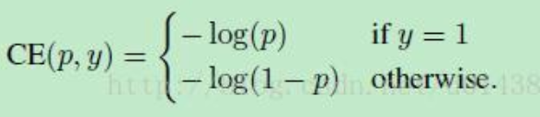
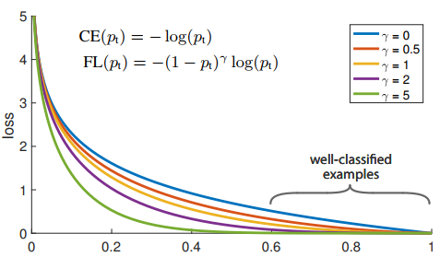
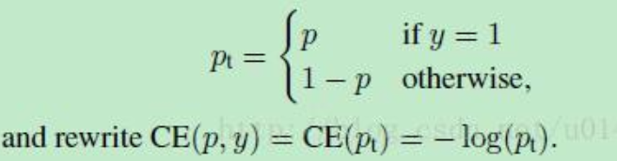
Focal loss FOCAL LOSS FOR DENSE OBJECT DETECTION iccv2017 BEST PAPER
PREDICT passable
Pt 0~1
Notes:
Focal Loss，大大降低那些負樣本的Loss Contribution，
預測還行 LOSS 低
One-Stage want prdict classification localization on Extracted Feature Map
One image generate 100000（Anchors），
Positive samples less
Training sampling imbalance
容易被歸類的負樣本背景區域（well-classified negative samples）
即使這些well-classfied samples每一個所貢獻的loss很小 但很多還是佔了全部loss的很大部分
需要被分類的positive samples貢獻的loss不明顯，梯度傳播就不夠準確。
想成一個loss函數，由於noise太多，minima不明顯

Slide 55
Choosing scales and aspect ratios for default boxes
handle different object scales 1.processing the image at different sizes and combining the results afterwards 2.utilizing feature maps from several different layers in a single network for prediction we can mimic the same effect

Slide 56
Choosing scales and aspect ratios for default boxes
Previous works have shown that using feature maps from the lower layers can improve semantic segmentation quality because the lower layers capture more fine details of the input objects
adding global context pooled from a feature map can help smooth the segmentation results

Slide 57
Choosing scales and aspect ratios for default boxes
Feature maps from different levels within a network are known to have different (empirical) receptive field sizes
In practice, one can also design a distribution of default boxes to best fit a specific dataset. How to design the optimal tiling is an open question as well

Slide 58
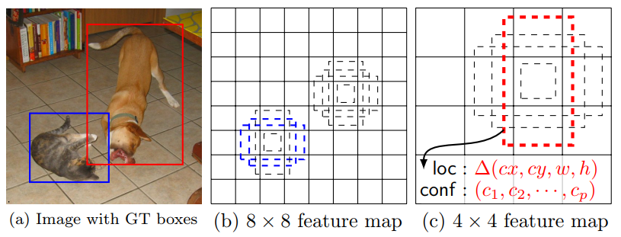
Choosing scales and aspect ratios for default boxes
the dog is matched to a default box in the 4 × 4 feature map, but not to any default boxes in the 8 × 8 feature map. This is because those boxes have different scales and do not match the dog box, and therefore are considered as negatives during training.

Slide 59
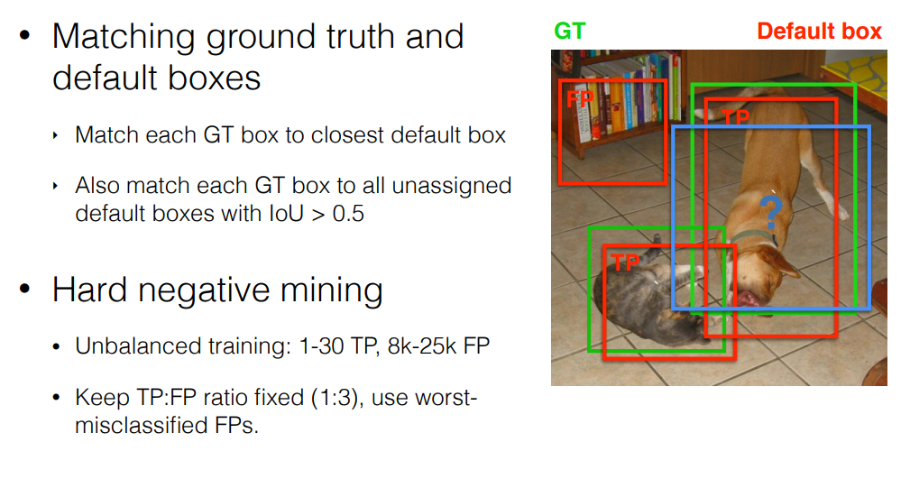
FROM eccv 2016 oral presentation

Slide 60
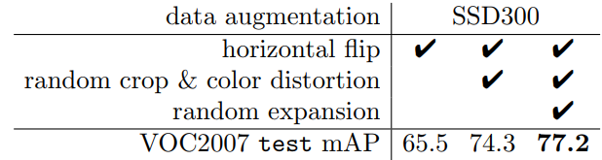
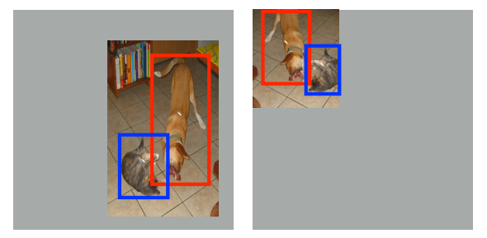
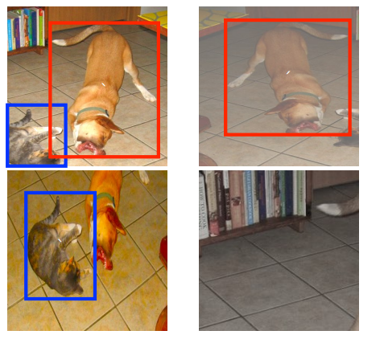
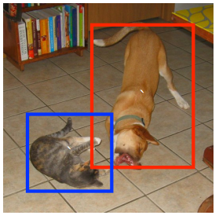
Data Augmentation
Random expansion creates more small training examples
each sampled patch is resized to fixed size and is horizontally flipped with probability
of 0.5, in addition to applying some photo-metric distortions similar to those described

Slide 61
Experimental Results
Conv3-64
Conv3-64
Conv3-64
Conv3-64
Base network:
Based on VGG16
Pre-trained on ILSVRC CLS-LOC dataset
Using SGD with initial learning rate 10^-3
maxpool
maxpool
Conv3-128
Conv3-128
Conv3-128
Conv3-128
maxpool
maxpool
Conv3-256
Conv3-256
Conv1-256
Conv3-256
Conv3-256
Conv1-256
maxpool
maxpool
Conv3-512
Conv3-512
Conv1-512
Conv3-512
Conv3-512
Conv1-512
maxpool
maxpool
Conv3-512
Conv3-512
Conv1-512
Conv3-512
Conv3-512
Conv1-512
Maxpool m/
maxpool
diconv3
fc6
conv1
fc7
Notes:
減少池化層?，
但是這樣直接就改變了原先可用的結構了，
而且最重要的一點是就不能用以前的結構參數進行微調了。
所以，Deeplab這裡使用了一個非常優雅的做法：將pooling的stride改為1，再加上1 padding。這樣池化後的圖片尺寸並未減小，並且依然保留了池化整合特徵的特性。
但是，事情還沒完。因為池化層變了，後面的卷積的感受野也對應的改變了，這樣也不能進行微調了。所以，Deeplab提出了一種新的卷積，帶孔的 卷積：Atrous Convolution。即：

Slide 62
Deeplab - largeFOV
We change pooling from 2x2-s2 to 3x3-s1 and with padding => same size
but receptive of view is change,it can’t fine tune

Slide 63
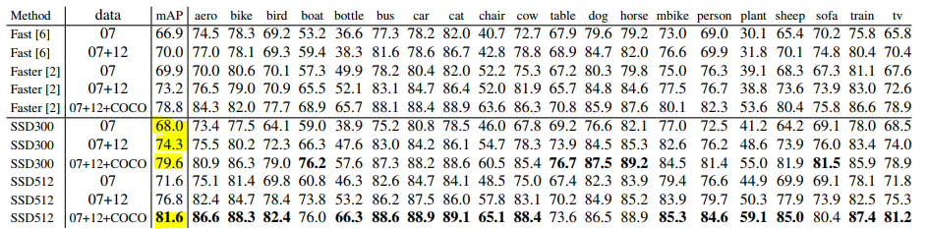
PASCAL VOC 2007
If we train SSD with more (i.e. 07+12) data, we see that SSD300 is already better
than Faster R-CNN
If we take models trained on COCO trainval35k as described in Sec. 3.4and fine-tuning them
on the 07+12 datasetW ith SSD512, we achieve the best results: 81.6% mAP

Slide 64
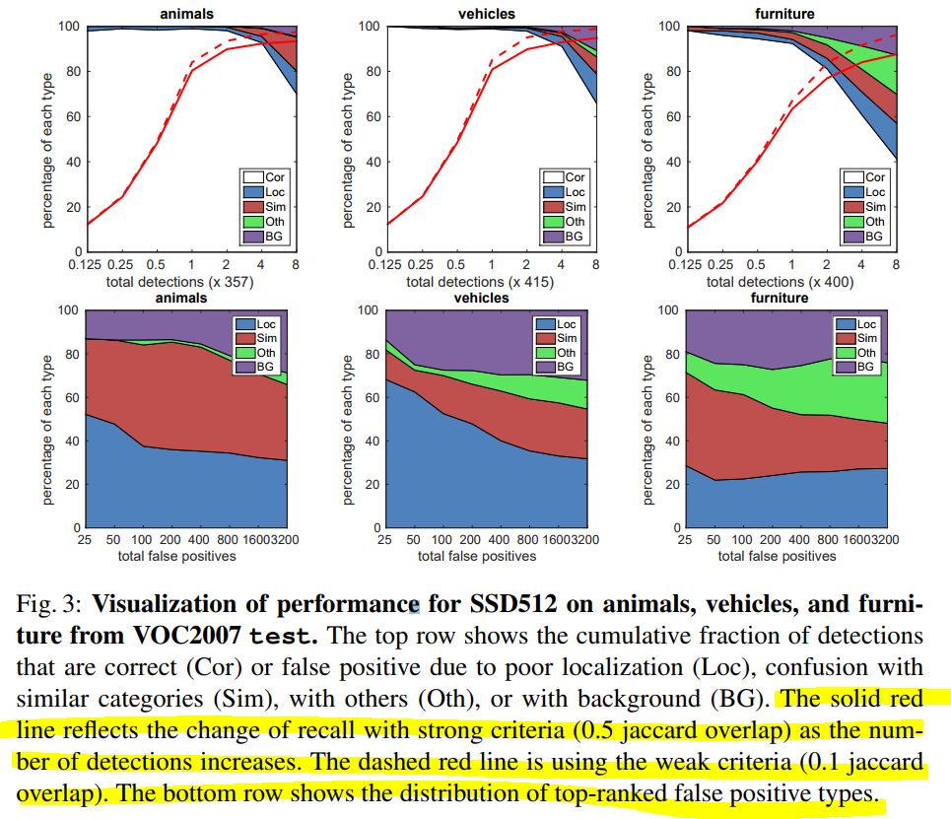
Visualization of performance for SSD512
SSD has less localization error, indicating
that SSD can localize objects better because it
directly learns to regress the object shape and
classify object categories instead of using two
decoupled steps

Slide 65
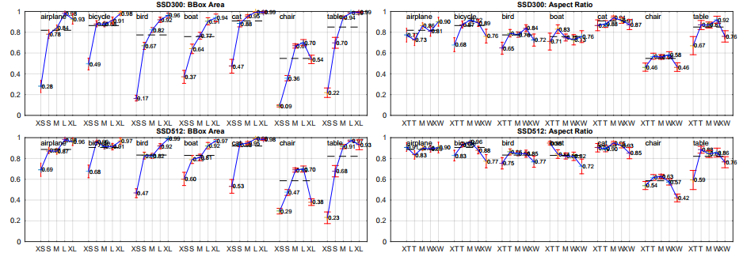
Sensitivity and impact of different object characteristics
shows that SSD is very sensitive to the bounding box size.
In other words, it has much worse performance on smaller
objects than bigger objects

Slide 66
Sensitivity and impact of different object characteristics
This is not surprising because those small objects may not even have any information at the very top layers.
we can clearly see that SSD performs really well on large objects. And it is very robust to different object aspect ratios because we use default boxes of various aspect ratios per feature map location.

Slide 67
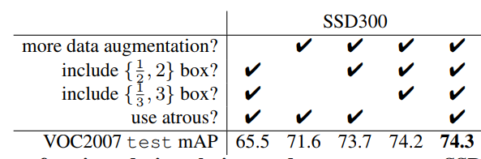
Model analysis
we carried out controlled experiments to examine how each component affects performance
Data augmentation is crucial
CAN IMPROVE 8.8% mAP
Notes:
Fast and Faster R-CNN use the original image and the horizontal flip to train

Slide 68
Model analysis
We do not know how much our sampling will benefit Fast and Faster R-CNN, but they are likely to benefit less because they use a feature pooling step during classification that is relatively robust to object translation by design.
ROI POOLING

Slide 69


More default box shapes is better
Using a variety of default box shapes seems
to make the task of predicting boxes easier for
the network
SmoothL1 or L2 loss for box shape
averages among likely hypotheses
Need to have enough default boxes
(discrete bins) to do accurate regression in each

Slide 70

Multiple output layers at different resolutions is better
A major contribution of SSD is using default boxes of different scales on different output layers

Slide 71
Multiple output layers at different resolutions is better
When we stack boxes of multiple scales on a layer, many are on the image boundary and need to be handled carefully
We observe some interesting trends. For example, it hurts the performance by a large margin if we use very coarse feature maps (e.g. conv11 2 (1 × 1) or conv10 2 (3 × 3)). The reason might be that we do not have enough large boxes to cover large objects after the pruning
When we use primarily finer resolution maps, the performance starts increasing again because even after pruning a sufficient number of large boxes remains.

Slide 72
Multiple output layers at different resolutions is better
If we only use conv7 for prediction, the performance is the worst, reinforcing the message that it is critical to spread boxes of different scales over different layers. Besides, since our predictions do not rely on ROI pooling as in [6], we do not have the collapsing bins problem in low-resolution feature maps
The SSD architecture combines predictions from feature maps of various resolutions to achieve comparable accuracy to Faster R-CNN, while using lower resolution input images

Slide 73

PASCAL VOC2012
we use VOC2012 trainval and VOC2007 trainval and test (21503 images) for training, and test on VOC2012 test

Slide 74

COCO
Since objects in COCO tend to be smaller than PASCAL VOC, we use smaller default boxes for all layers
Notes:
??????????????????????
??????????????????????
??????????????????????
??????????????????????
??????????????????????
??????????????????????
??????????????????????
??????????????????????
??????????????????????
??????????????????????
??????????????????????
??????????????????????
??????????????????????
??????????????????????
??????????????????????
??????????????????????
??????????????????????
??????????????????????
??????????????????????
??????????????????????
??????????????????????
??????????????????????
??????????????????????
??????????????????????
??????????????????????

Slide 75

Data Augmentation for Small Object Accuracy
small objects is relatively hard for SSD, as demonstrated in our analysis
The data augmentation strategy helps to improve the performance dramatically, especially on small datasets such as PASCAL VOC
Notes:
obvious that the new data augmentation trick helps detecting small objects significantly

Slide 76

Inference time
it is essential to perform non-maximum suppression (nms) efficiently during inference
SSD300 is the first real-time method to achieve above 70% mAP. Note that about 80% of the forward time is spent on the base network (VGG16 in our case). Therefore, using a faster base network could even further improve the speed, which can possibly make the SSD512 model real-time as well

Slide 77
non-maximum suppression
0.9
0.8
0.6
0.4

Slide 78
non-maximum suppression
0.9
if
IOU>0.5
0.8
=0

Slide 79
non-maximum suppression
0.9
if
IOU>0.5
=0
0.6

Slide 80
non-maximum suppression
0.9
0.8
0

Slide 81
Related work
if we use the whole topmost feature map and add a fully connected layer for predictions instead of our convolutional predictors, and do not explicitly consider multiple aspect ratios, we can approximately reproduce YOLO

Slide 82

DSSD
Notes:
方法就是把紅色層做反卷積操作，使其和上一級藍色層尺度相同，再把二者融合在一起，得到的新的紅色層用來做預測。
如此反复，仍然形成多尺度檢測框架。在圖中越往後的紅色層分辨率越高，而且包含的上下文信息越豐富，綜合在一起，使得檢測精度得以提升
其一，檢測只算是基礎目標，還有很多後續任務，因此必須考慮速度，做成對稱的那速度就快不起來。
其二，目前並沒有現成的包含解碼（反卷積）的預訓練模型，意味著模型必須從零開始學習這一部分，做成對稱的則計算成本就太高了。

Slide 83



FPN

Slide 84
Conclusions
use of multi-scale convolutional bounding box outputs attached to multiple feature maps at the top of the network
a larger number of carefully chosen default bounding boxes results in improved performance
Our SSD512 model significantly outperforms the state-of-theart Faster R-CNN [2] in terms of accuracy on PASCAL VOC and COCO,

Slide 85

appendix

Slide 86
ref
Speed/accuracy trade-offs for modern convolutional object detectors
Notes:
mPA是對象檢測算法中衡量算法的精確度的指標，
涉及兩個概念：查准率精度，查全率回憶。對於物體檢測任務，
每個對像都可以計算出其Precision and Recall，多次計算/試驗，每個類都可以得到一條P-R曲線，
曲線下的面積就是AP的值，這個意思的意思是對每個類的AP再求平均，得到的就是MPA的值，MPA的大小一定在[0,1]區間。

